Slide 1
E54 MH & COMPACTOR
26 JAN 2024

Slide 2
PRESENTATION FLOW
Step 1 – General Drawing with main assemblies
Step 2 – Drawing of focused assembly
Step 3 – Identify components of the focus assembly
Step 4 – Basic condition specifications
Step 5 – Determine applicable maintenance plan
Step 6 – Critical Spares
Step 7 – KSR’s

Slide 3
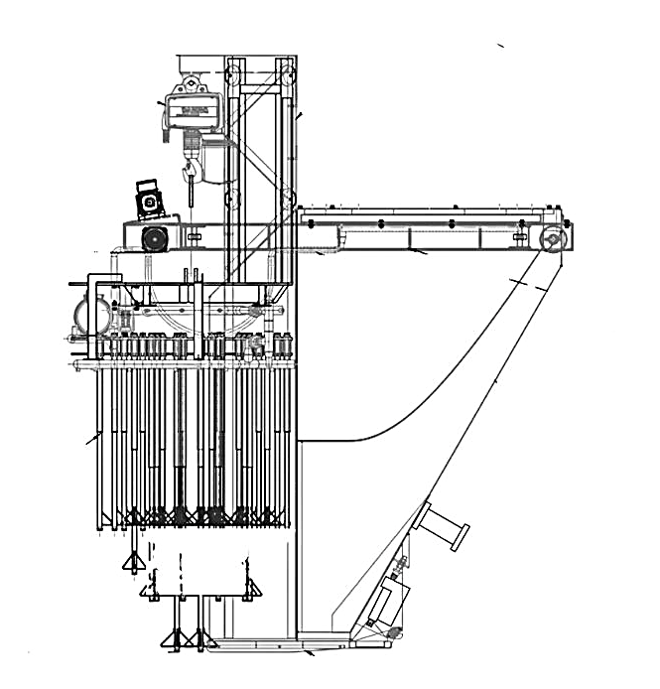
DRAWING
MOBILE HOPPER DRIVE ASSEMBLY
Geared Motor Assembly
Wheel Set
Guide Rollers
A
B
COMPACTOR ASSEMBLY
Vibrating Motor
Electric Hoist
Vibrating Tubes
Pre-Wetting Line
Vertical Guide Rollers
C
MOBILE HOPPER ASSEMBLY
Discharge Flap Cylinder
Knocking Device
Electrical Box
Hopper
Energy Chain Assembly

Slide 4
MOBILE HOPPER DRIVE ASSEMBLY
MOBILE HOPPER DRIVE ASSEMBLY
Geared Motor Assembly
1.1 Drive Motor
1.2 Gear Box
1.3 Drive Sprocket
1.4 Chain
1.5 Mounting Base
Wheel Set
2.1 Wheel Shaft
2.2 Driven Sprocket
2.3 Shaft Bearings
Guide Rollers
3.1 Roller Bearings
SIDE VIEW
1
2
2
3

Slide 5
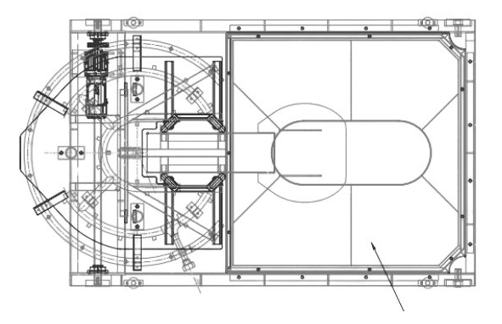
MOBILE HOPPER DRIVE ASSEMBLY
3
MOBILE HOPPER DRIVE ASSEMBLY
Geared Motor Assembly
1.1 Drive Motor
1.2 Gear Box
1.3 Drive Sprocket
1.4 Chain
1.5 Mounting Base
Wheel Set
2.1 Wheel Shaft
2.2 Driven Sprocket
2.3 Shaft Bearings
Guide Rollers
3.1 Roller Bearings
3
TOP VIEW
2
1
2
2
3
3

Slide 6
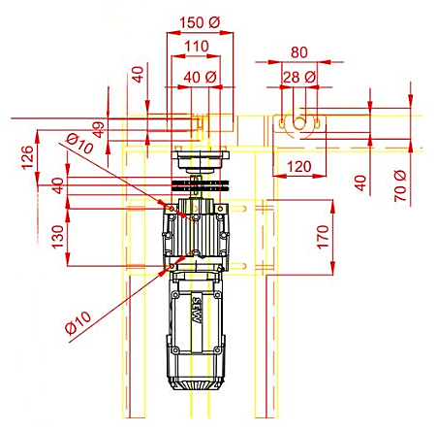
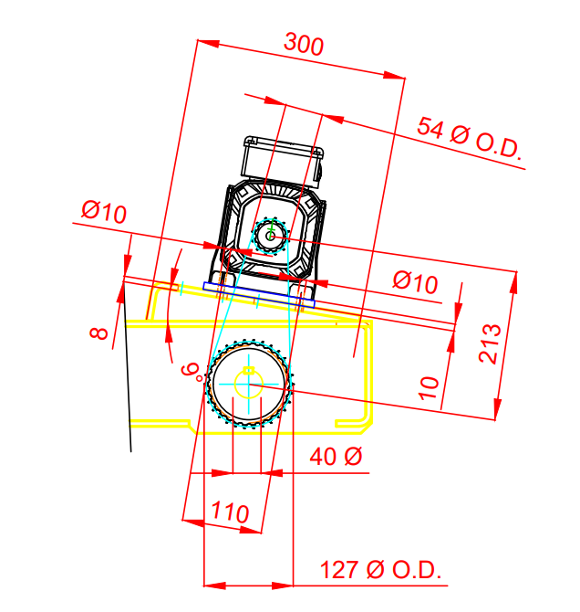
1.5
1.3
1.2
1.4
1.1
Geared Motor Assembly
1.1 Drive Motor
1.2 Gear Box
1.3 Drive Sprocket
1.4 Chain
1.5 Mounting Base

Slide 7
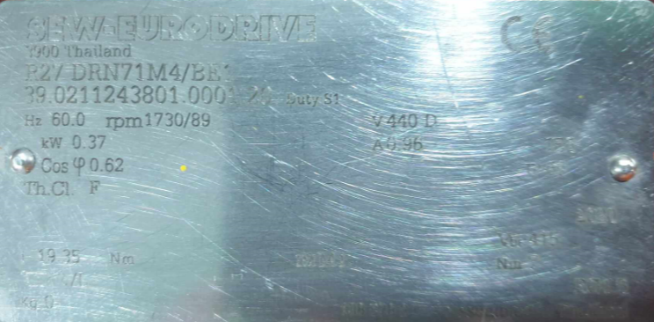
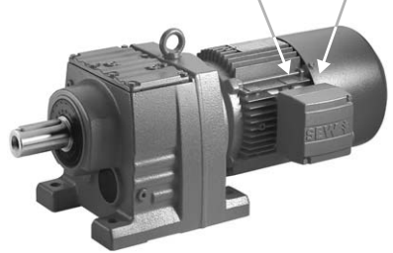
BASIC SPECS OF DRIVE MOTOR
Type designation gearmotor R27 DRNR1M4/BE1
Serial Number 39.0211243801.0001.20
Line frequency, Hz 60
Supply voltage, volt 440, 3-phase
Clamping connection Delta + GND
Speed ratio 1730/89
Motor power, kW 0.37
Power factor 0.62
Temperature class F
Max output torque, Nm 19.35
Full load current, Amp 0.96
Degree of protection IP65
Brake voltage, Volt 440, 1-phase
Braking torque, Nm 7
Brake control BG1.5
Inverter operation Duty S1 (continuous)
Mounting position M1 (foot-mounted)

Slide 8
1.1 Specification OF DRIVE MOTOR
COMPONENT | SPECIFICATIONS | BASIC CONDITION SPECIFICATION
Winding | Resistance: 33 ohms Insulation: >10 megaohm Full load current: 0.96 amp Supply voltage: 440V, 3 phase Power rating: 0.37 kW | As per Specification. Measure only when motor Circuit Breaker is OFF.
Terminal box | Clamping connection: M4 x 4 | M4 x 4 with Tightening Torque: 5 Nm
Drive End Bearing | Double sealed 6204 2Z-C3-K52 | No unusual sound.
Non-Drive End Bearing | Double sealed 6203 2Z-C3-K52 | No unusual sound.
Motor frame | Temperature <80 degC | As per Specification.
BG1.5 Brake module | Supply voltage: 440V, Single phase | As per Specification.
Drive Gear Flange Bolt | M8 x 20mm x 4 | M8 x 20mm x 4 with Tightening Torque: 40Nm
Speed | 1730 rpm | Fast: 60hz, 1730 rpm/19.4 (full speed) → Slow: 20hz, 577 rpm/ 19.4 →
Protection classification | IP67 | Protection limit: Complete protection against dust. Water immersion under pressure between 0.015barg to 0.1 barg

Slide 9
1.5
1.3
1.2
1.4
1.1
Geared Motor Assembly
1.1 Drive Motor
1.2 Gear Box
1.3 Drive Sprocket
1.4 Chain
1.5 Mounting Base

Slide 10
1.2 BASIC CONDITION SPECS OF GEAR BOX
COMPONENT | SPECIFICATIONS | BASIC CONDITION SPECIFICATION
1.1Gear Box | Gear ratio: 19.4 RPM: 1730/89 Torque: 19.8 Nm Shaft dia: 25mm, 50C4 Carbon steel, 5mm depth Keyway Shaft seal: 25mm, Fluorocarbon rubber. Keybar: 40mm x 8mm depth, carbon steel Mounting bolts/nuts: 10mm x 50mm Cover plate bolt: M6 x 8 | No cracks in footings. No unusual sound. Bolts and nuts secured and complete (10mm x 50mm x 4), Torque: 48Nm Keybar intact to its keyway. No signs of leaks at shaft seal. No signs of leaks at gearbox body, oil level at 75mm +/-1mm from sealing surface ≈ 0.25L. Cover plate secured with complete bolts (M6 x 8), torque: 11 Nm. Temperature <80 degC Oil is clean and not contaminated. Top sealing surface is clean and dry. Installation Position: 9degrees angle
 | Lubricant qty: 0.25 L Type: Klubber 220- food grade oil

Slide 11
1.5
1.3
1.2
1.4
1.1
Geared Motor Assembly
1.1 Drive Motor
1.2 Gear Box
1.3 Drive Sprocket
1.4 Chain
1.5 Mounting Base

Slide 12
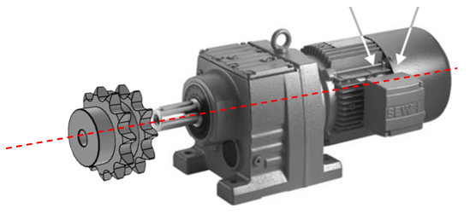
1.3-1.4 SPECS OF DRIVE SPROCKET & CHAIN
COMPONENT | SPECIFICATIONS | BASIC CONDITION SPECIFICATION
Drive Sprocket | Number of teeth: 12 Pitch circle: 120mm Inner diameter: 25mm Keyway: 6mmx5mm depth Set screw: 6mm diameter | No signs of wear, such as worn-out teeth, rough surfaces, or deformation of the tooth profile. Well lubricated with LMI300 LUBCON turmofluid Spray Free from dirt and contaminants. Set screw torque= 12 Nm.
Chain Drive Duplex Chain 60-2 | Length: 762mm Pitch: 19mm Overall width: 48mm Pin dia: 6mm | No worn-out chain links. Connecting link lock intact. Well lubricated with LMI300 LUBCON turmofluid Spray Free from dirt and contaminants. Slackness: 15 to 20 mm

Slide 13
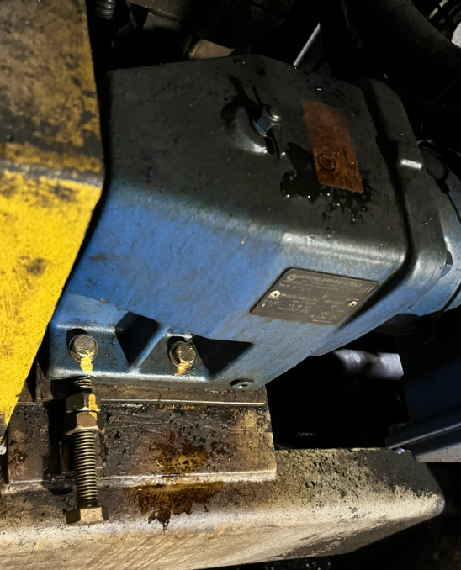
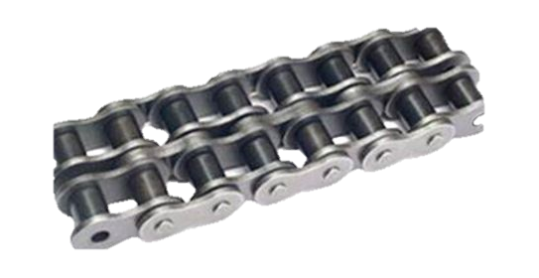
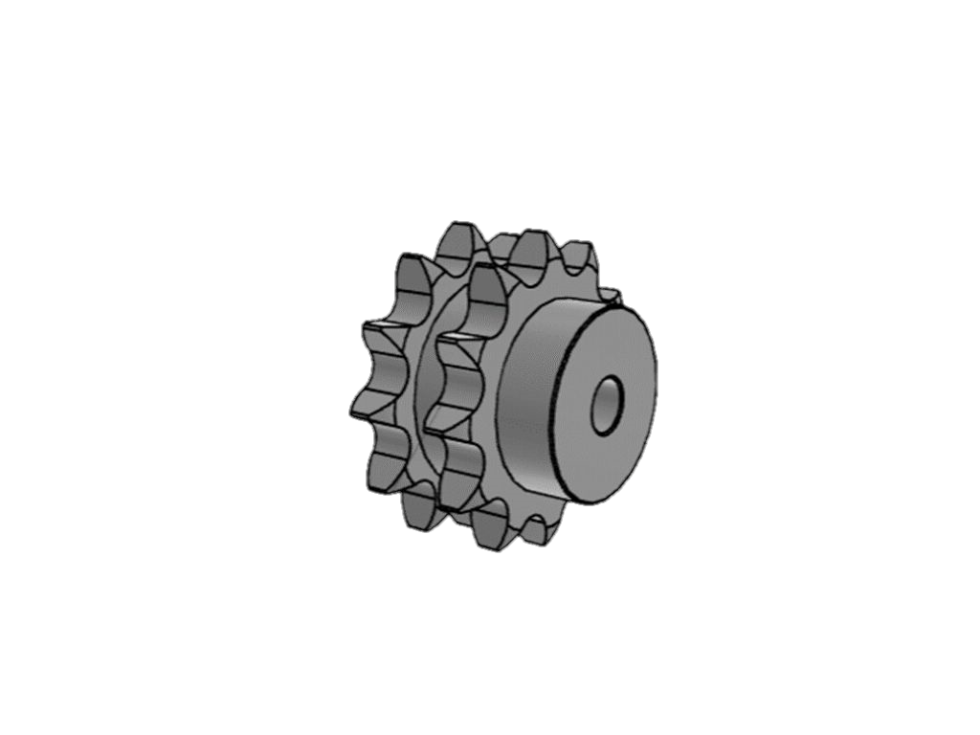

Slide 14
1.5
1.3
1.2
1.4
1.1
Geared Motor Assembly
1.1 Drive Motor
1.2 Gear Box
1.3 Drive Sprocket
1.4 Chain
1.5 Mounting Base

Slide 15
1.5 BASIC CONDITION SPECS OF MOUNTING BASE
COMPONENT | SPECIFICATIONS | BASIC CONDITION SPECIFICATION
Base Plate Mounting | SS 304 Plate dimension: 160mmX160mmx10mm | Complete set of 4 bolts & nuts, torque: 48Nm. No signs of bending or cracks. No signs of cracks (hair line cracks) at welding joints.
 | bolt holes: 10mmx4
 | Position installation: 9deg angle
 | Bolt size: 10mm x 50mm

Slide 16
1. MAINTENANCE PLANS
ACTIVITY | FREQUENCY | REMARKS
E54 MH Geared motor inspection | 6 months | Maintenance Plan 0910-030-230
E54 MH Geared motor inspection | 1 Month | Maintenance Plan 0910-030-369
E54 MH Geared motor change oil | 52 Weeks | Maintenance Plan 0910-030-
E54 MH Drive motor winding and terminal tests | Every 52 weeks | For enrolment as PM03
E54 MH Drive motor bearing replacement | Every 104 weeks | For enrolment as PM03, external services
E54 MH Drive motor brake assembly replacement | Every 104 weeks | For enrolment as PM03, external services
E54 MH Drive motor thermal scan | Once per shift | Include in KSR of MWG
E54 MH Chain and sprocket Inspection | Every i-CIP | Include in KSR of MWG
E54 MH Geared motor assembly cleaning | Every i-CIP | Include in KSR of MWG
E54 MH Chain and sprocket lubrication | Every CIP | Include in KSR of MWG

Slide 17
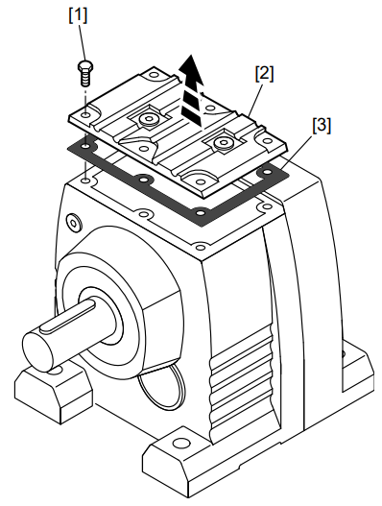
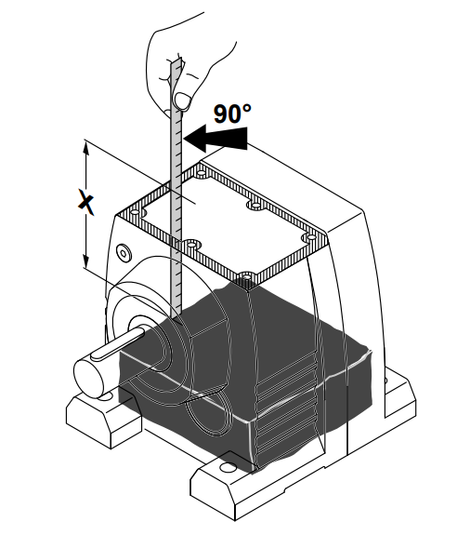
1. MAINTENANCE PLANS
 |  | Maintenance Task
What | E54 MH Geared motor inspection | A. Check running unusual noise for possible bearing damage. B. Visual inspection of the seals for leakage. C. Check for any cracks along the footings (x4) by using Dye Penetrant Test liquid. D. Checking of Oil: Loosen the M6 x 8 screws [1] of the cover plate [2] and remove the cover plate [2] and the corresponding gasket [3]. Open the cover plate of the gear unit. Change oil, if contaminated with dust, water and coffee grounds. Change gearbox if oil has signs of metal chipping contamination. Check oil level and determine vertical distance between oil level and sealing surface of the gear unit housing. LEVEL = 75mm +/- 1mm using clean measuring tool (e.g. ruler). Close the gear unit after the oil level check: • Re-attach the gasket of the cover plate. Make sure that the sealing surfaces are clean and dry. • Screw on the cover plate. Tighten the cover screws (M6 x 8), Torque: 11 Nm.
When | 6M
Where | E54 Mobile Hopper
Which | 6mm Allen wrench Ruler or dip stick and steel tape

Slide 18
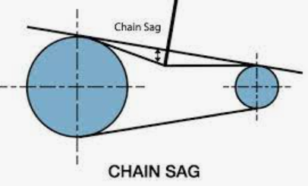
1. MAINTENANCE PLANS
 |  | Maintenance Task
What | E54 MH Geared motor inspection | Remove machine guard (10mm bolts/nuts). Check for any cracks along the footings (x4) by using DPT liquid. Check for any signs of deformation at the mounting base plate. Check for any signs of cracks at the welding joint of the mounting base plate using Dye Penetrant Test liquid. Retighten mounting bolts 10mm x 50mm, torque: 48Nm. Visual inspection of the seals for leakage. Check drive and driven sprocket condition. Retight drive and driven sprocket set screw, torque= 12 Nm. Check chain condition and slackness (15-20mm slack). Spray chain and sprocket with LMI300 LUBCON turmofluid Spray. Install back machine guard, fasten 10mm bolts with torque= 48Nm.
When | 1M or every CIP
Where | E54 Mobile Hopper
Which | #12 combination wrench (10mm bolt/nut) 6mm Allen wrench Torque wrench

Slide 19
1. MAINTENANCE PLANS
 |  | Maintenance Task
What | E54 MH Geared motor Change Oil | Loosen the screws [1] of the cover plate [2] and remove the cover plate [2] and the corresponding gasket [3]. Open the cover plate of the gear unit. Remove the oil. Refill oil at LEVEL = 75mm +/- 1mm by using clean measuring tool to check level. Close the gear unit after the oil refill: • Re-attach the gasket of the cover plate. Make sure that the sealing surfaces are clean and dry. • Screw on the cover plate. Tighten the cover screws (M6 x 8), Torque: 11 Nm.
When | 52W
Where | E54 Mobile Hopper
Which | 6mm Allen wrench Torque wrench

Slide 20
CRITICAL SPARE PARTS LIST
EQUIPMENT | MANUFACTURER | SAFETY STOCK | REORDER POINT | P.O. NUMBER
Electric Hoist | Demag | 1 | 1 | 4554107473
Gear Motor | SEW R27 | 1 | 1 | -SAME-
Duplex Chain 60-2 (10ft) | KANA | 1 | 1 | -SAME-
Double Drive Sprocket 12 teeth, pitch dia=120mm | KANA | 1 | 1 | -SAME-

Slide 24
